Slide 1
Terrestrial carbon fluxes
Silvia Caldararu
Email: caldaras@tcd.ie

Slide 2
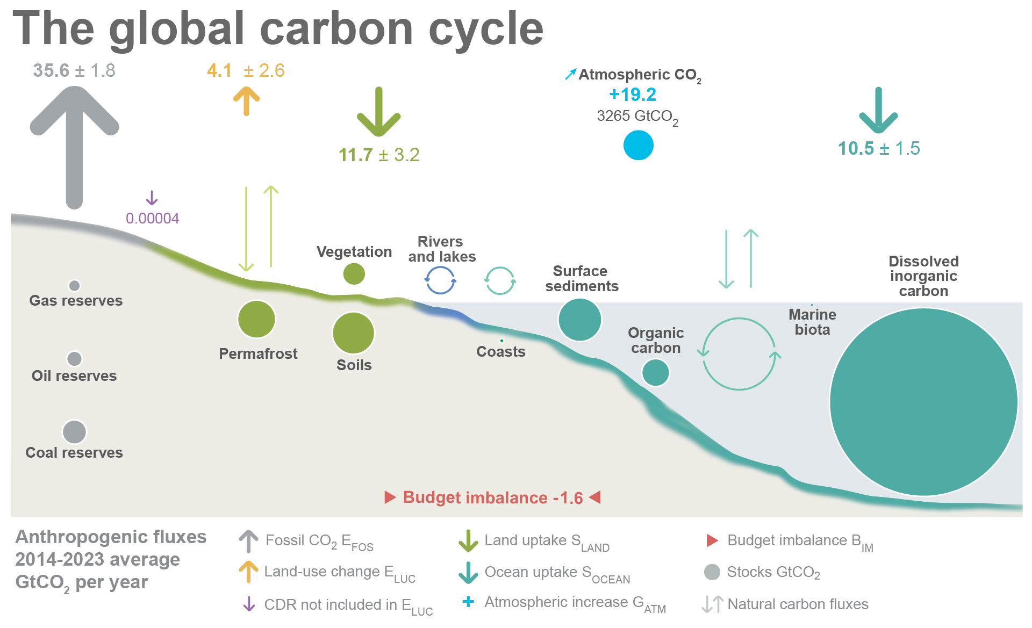

Slide 3
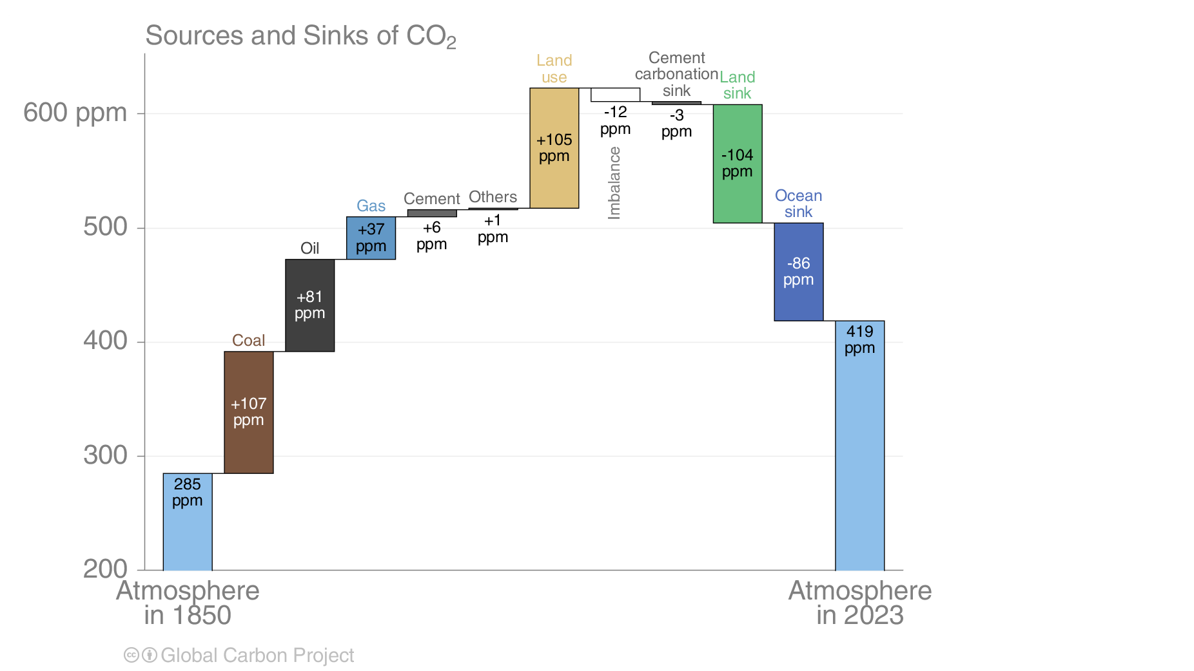

Slide 4
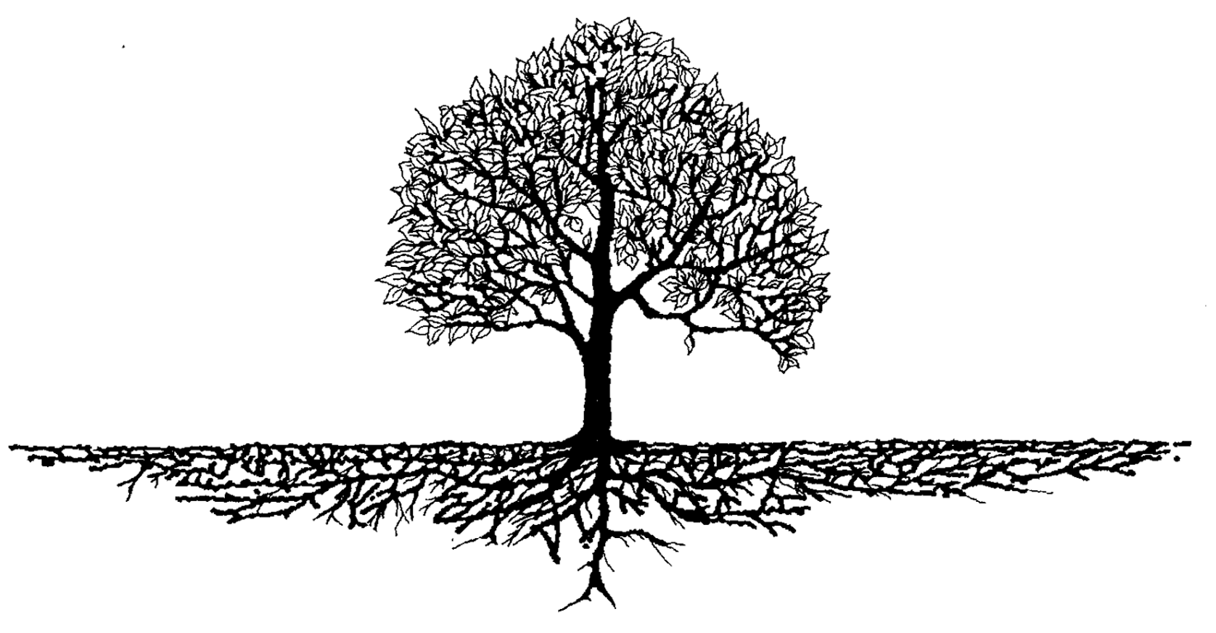
The ecosystem carbon cycle
C uptake:
photosynthesis
C release:
respiration
C release:
Soil respiration
C storage:
growth
Internal cycling::
litterfall
C storage in soil

Slide 5
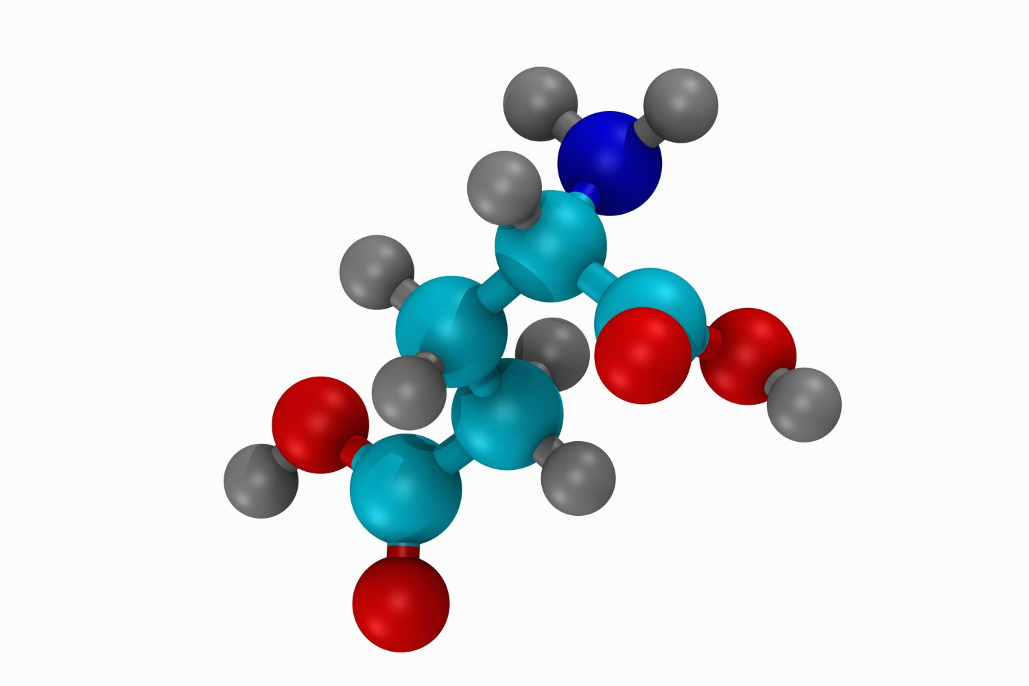
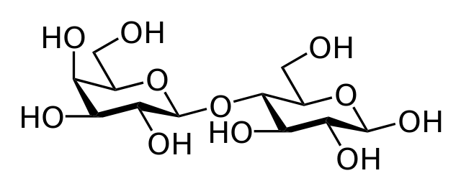
Carbon is the building block of organic matter
Carbohydrates
Proteins and genetic materials

Slide 6
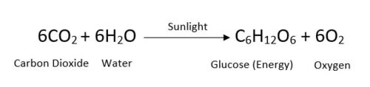
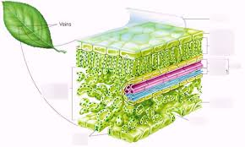
Photosynthesis is the process by which atmospheric CO₂ is transformed into sugars

Slide 7
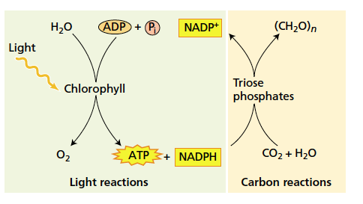
Photosynthesis biochemistry
Light dependent reactions which store energy from solar radiation in a way that can be used by plants
The Calvin cycle which transforms CO₂ into organic compounds using energy from light dependent reactions

Slide 8
You do not need to remember all the specific reactions!
Learn the Calvin cycle
THE REAL CALVIN CYCLE
Forget the Calvin cycle

Slide 9
Photosynthesis biochemistry
Both reactions need to happen together and both resources need to be sufficient

Slide 10
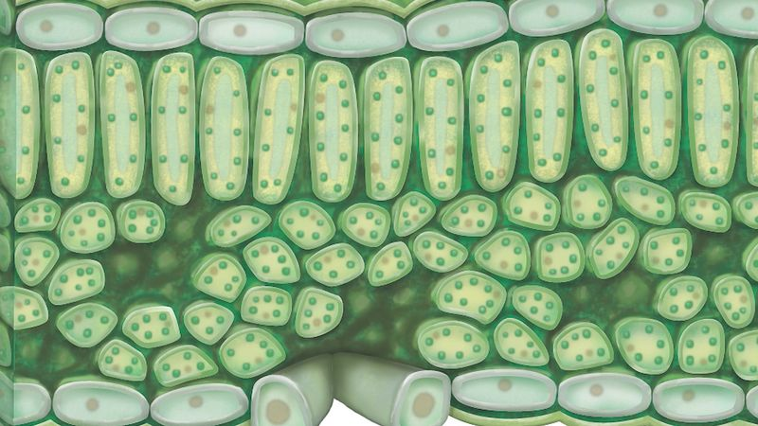
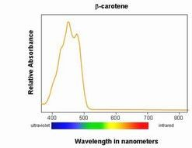
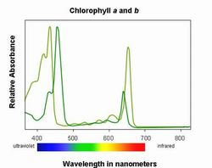
Light harvesting for photosynthesis
Different pigments absorb light at different wavelengths

Slide 11
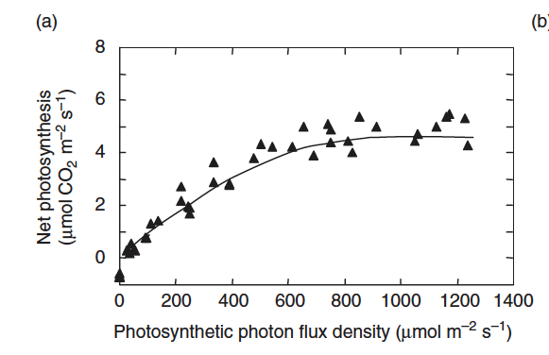
Photosynthesis dependency on light
Photosynthesis saturates when CO₂ becomes limiting
PPFD – portion of incoming solar radiation that can be used in photosynthesis
Also known as photosynthetic active radiation or PAR
Photosynthesis initially increases with light
Notes:
Ecological climatology, chapter 16

Slide 12
CO₂ available for photosynthesis
Atmospheric CO₂ enters the leaf through stomata

Slide 13
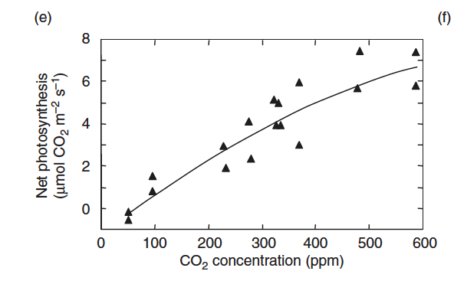
Photosynthesis dependency on CO₂
Photosynthesis keeps increasing beyond current atmospheric concentrations
Photosynthesis increases with CO₂ unless light is very low
Concentration in the atmosphere

Slide 14
CO₂ water trade offs
Stomata allow CO₂ to enter a leaf but also allow water to evaporate (transpire)
Plants have active control over their stomata closure

Slide 15
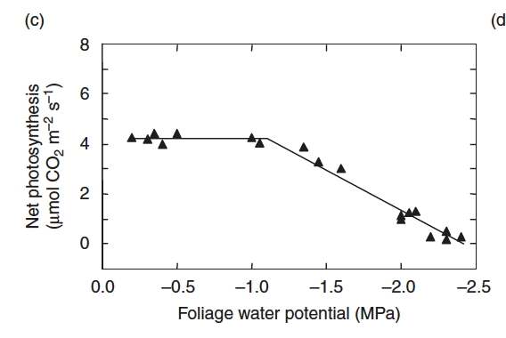
Photosynthesis dependency on water availability
Plants start to close their stomata and reduce their photosynthesis
Sufficient water so no effect on photosynthesis
Measure of water in the leaf

Slide 16
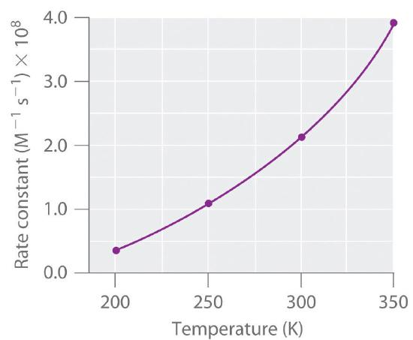
Chemical reaction rates are controlled by temperature
Higher temperature means more energy available for reactions to take place

Slide 17
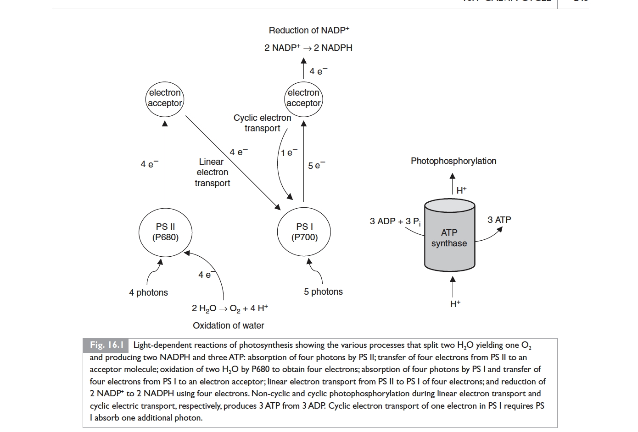
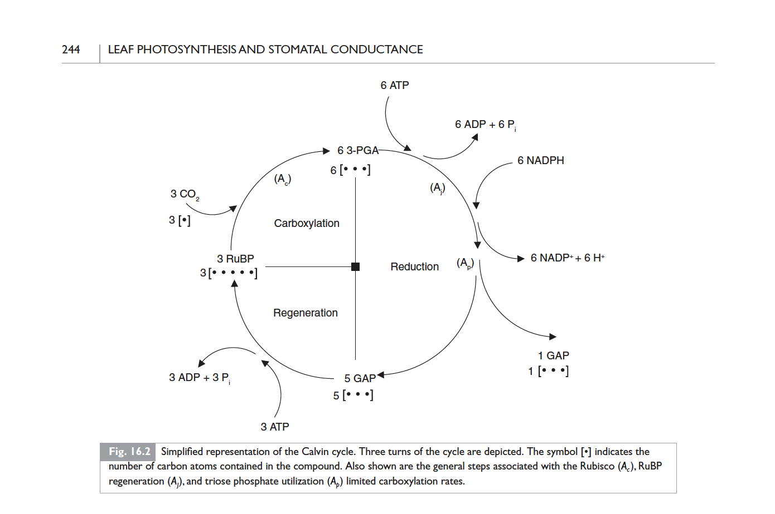
Photosynthetic reactions are complex and involve biochemistry and leaf structure and function

Slide 18
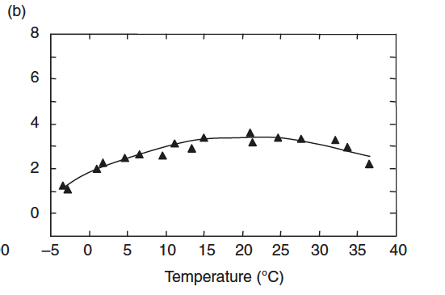
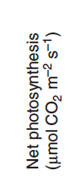
Photosynthesis dependency on temperature
Temperature optimum
Increase in temperature becomes detrimental to biological processses
Temperature increases reaction rates

Slide 19
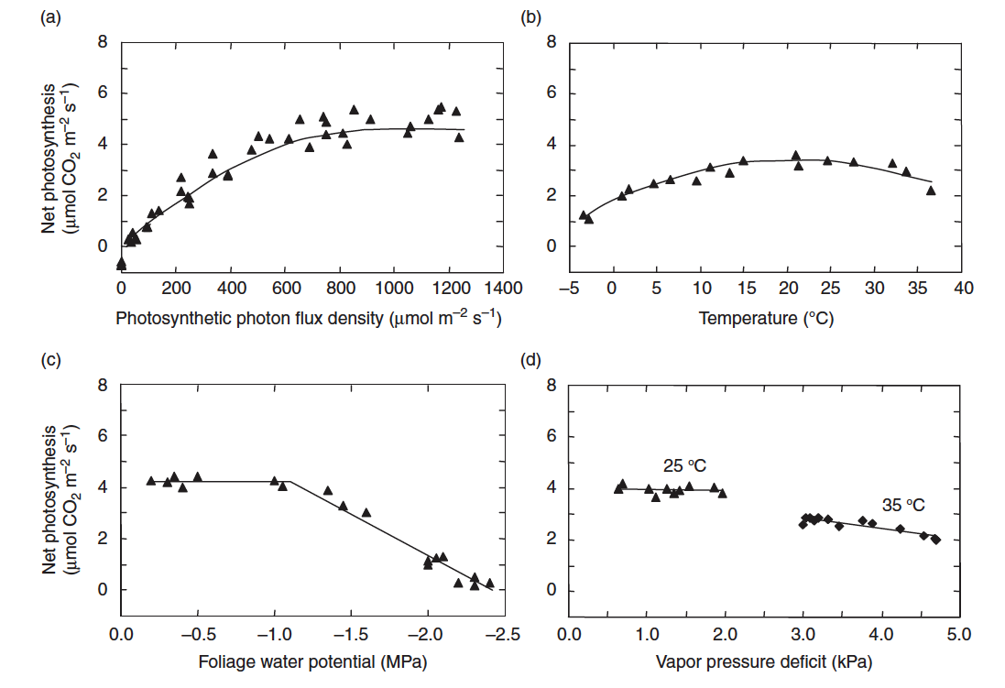
How would you expect photosynthesis to vary in a mid-latitude temperate climate?

Slide 20
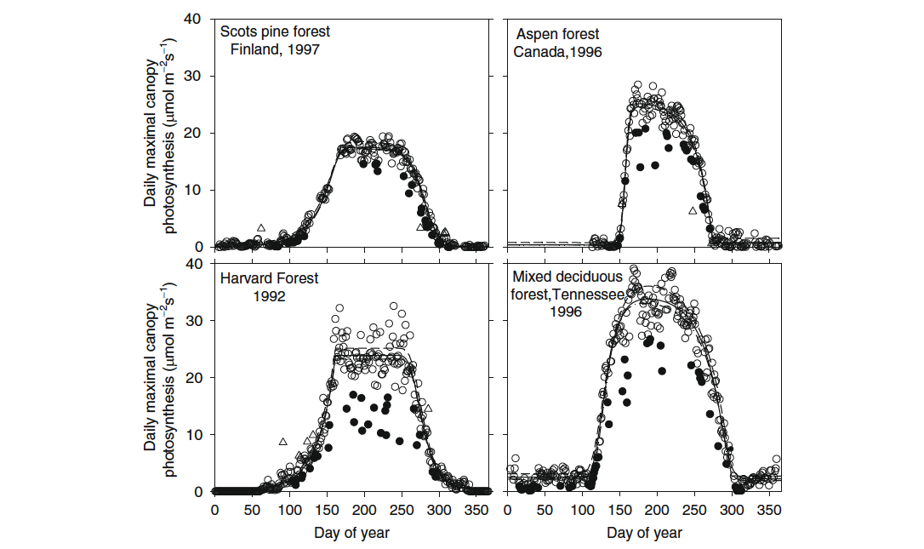
Notes:
Gu, L. et al. (2009). Characterizing the Seasonal Dynamics of Plant Community Photosynthesis Across a Range of Vegetation Types. In: Noormets, A. (eds) Phenology of Ecosystem Processes. Springer, New York, NY. https://doi.org/10.1007/978-1-4419-0026-5_2

Slide 21
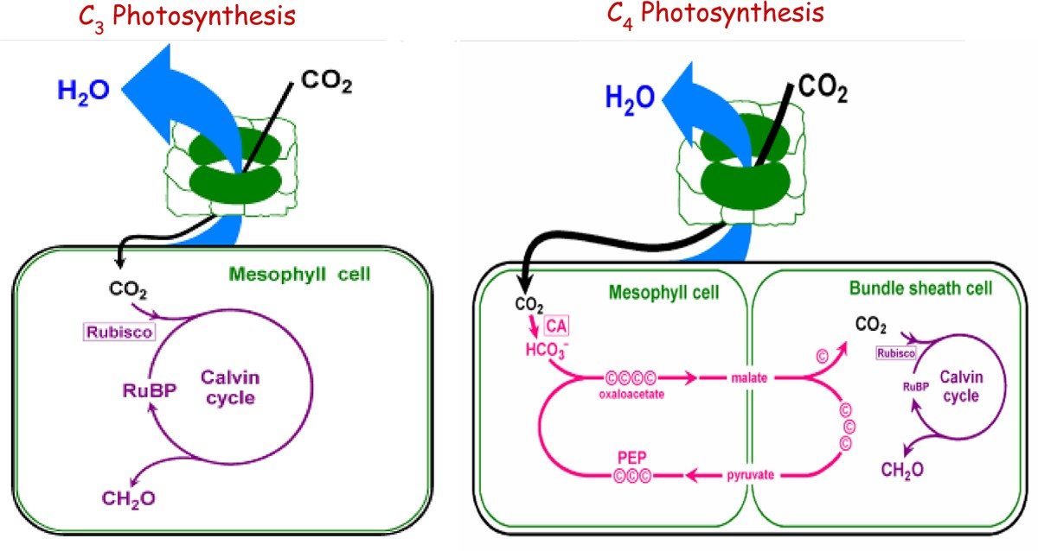
Types of photosynthesis: C3 vs. C4
C4 plans have a physical separation between the different parts of photosynthetic apparatus, which gives them an advantage in warmer, drier climates

Slide 22
Types of photosynthesis: C3 vs. C4

Slide 23
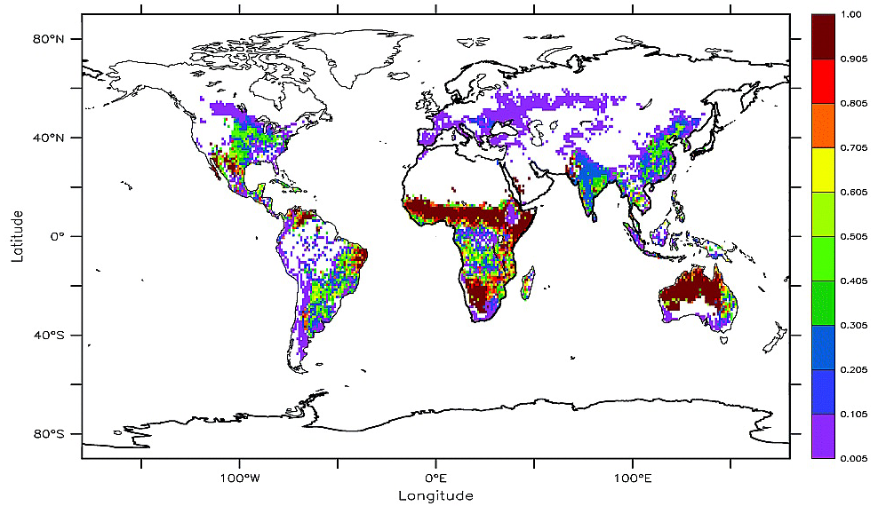
Fraction of C4 plants

Slide 24
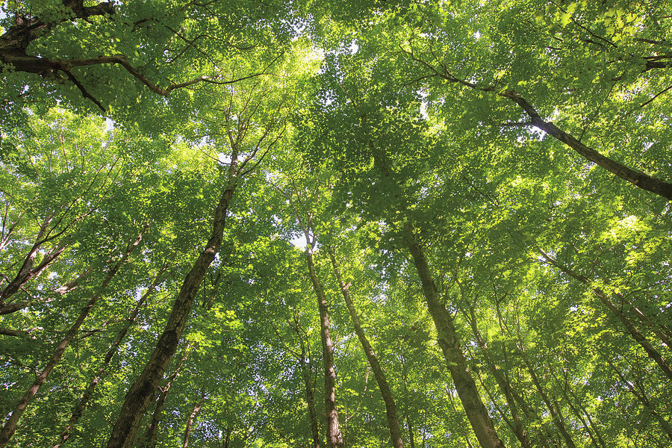
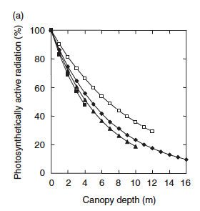
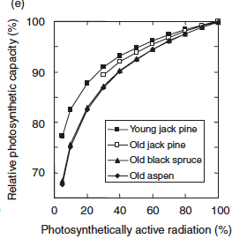
Photosynthesis at the canopy level
Notes:
Ecological Climatology chapter 17

Slide 25
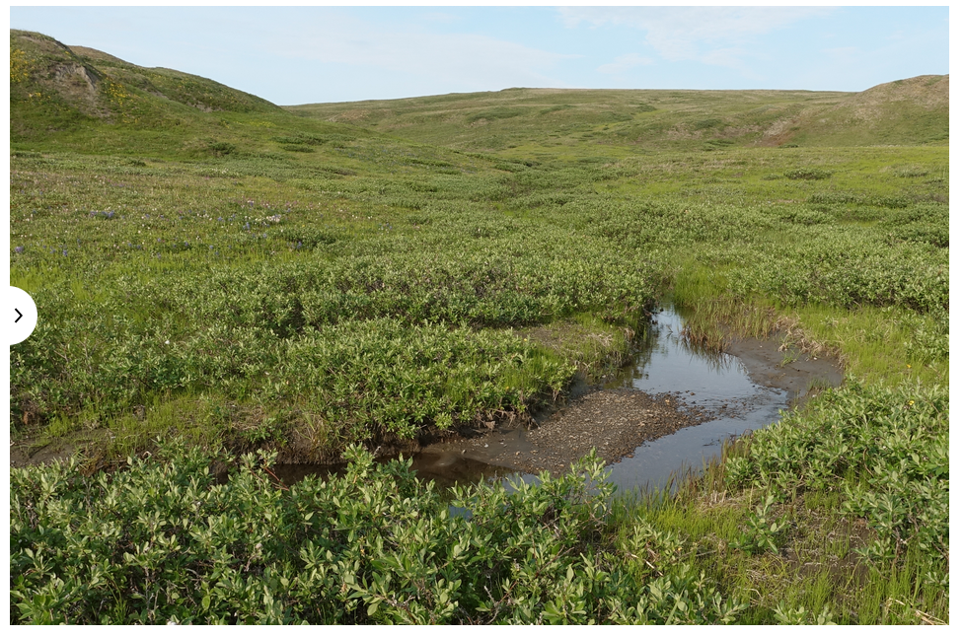
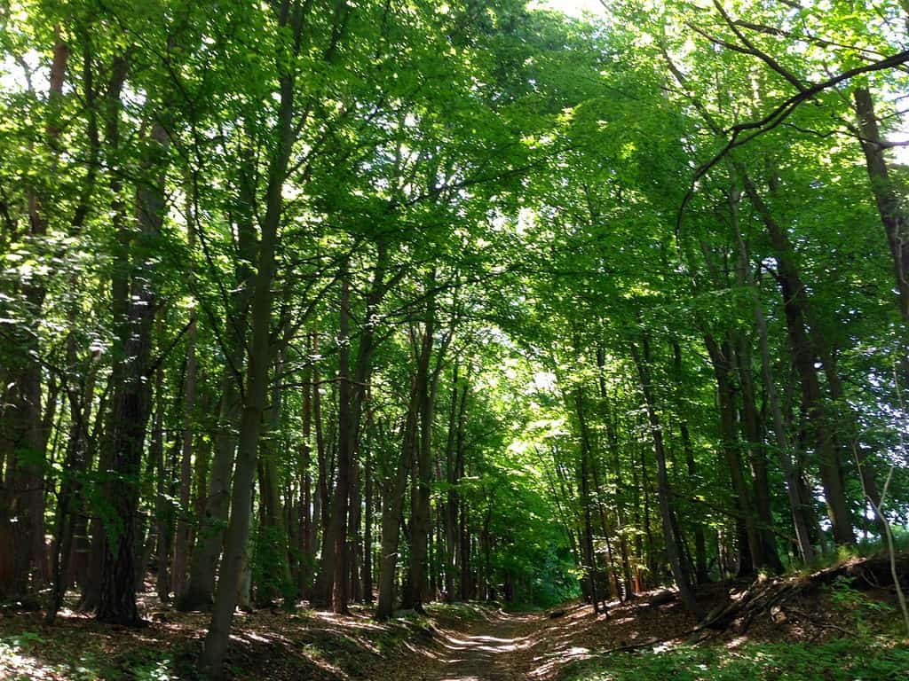
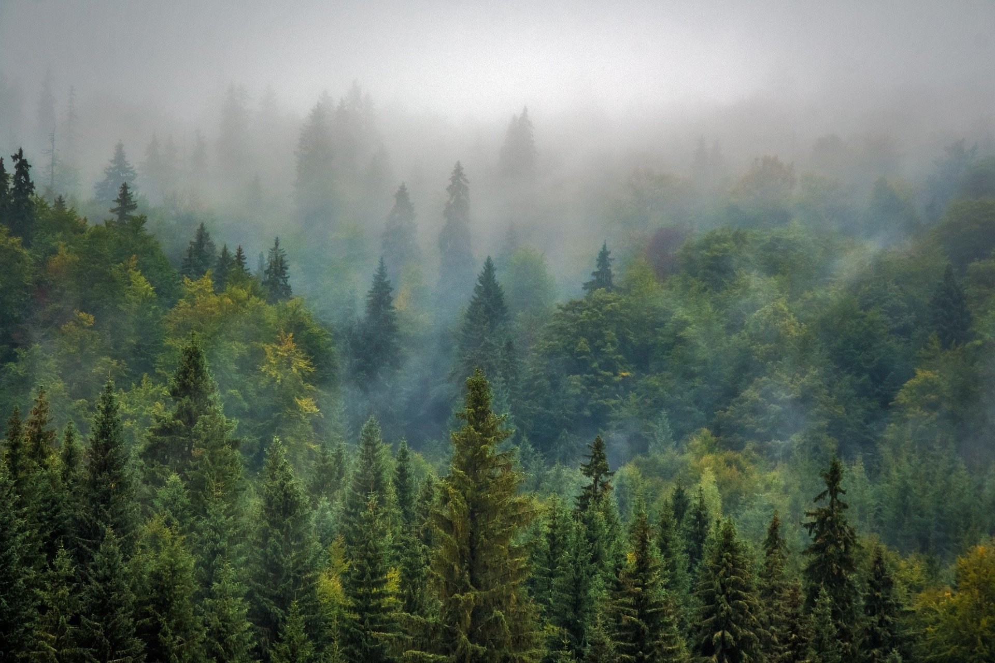
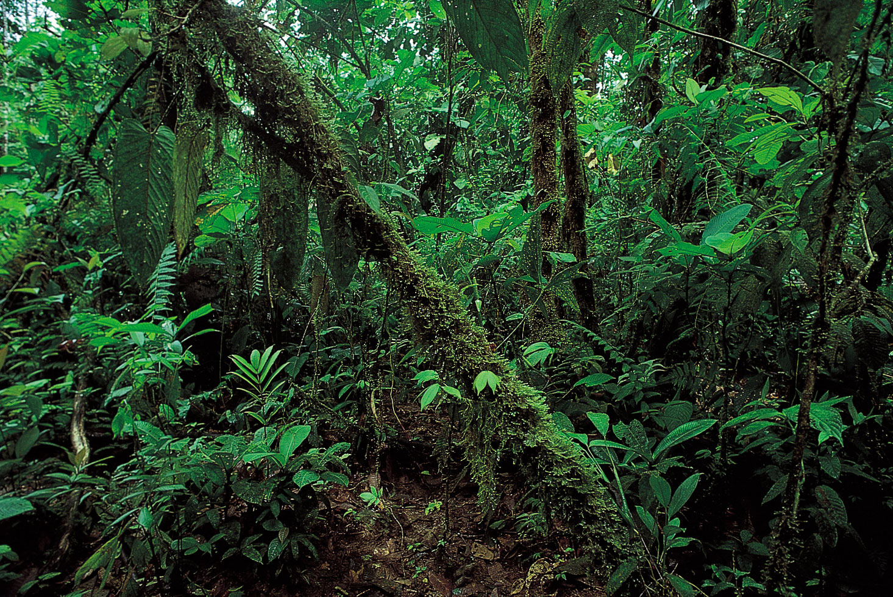
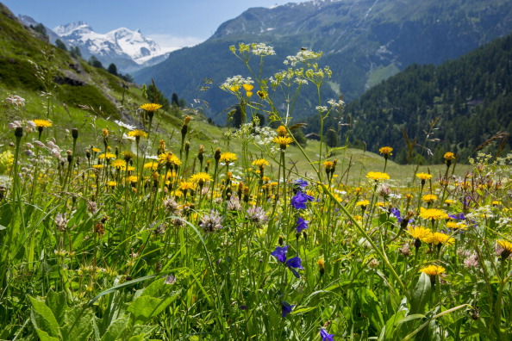
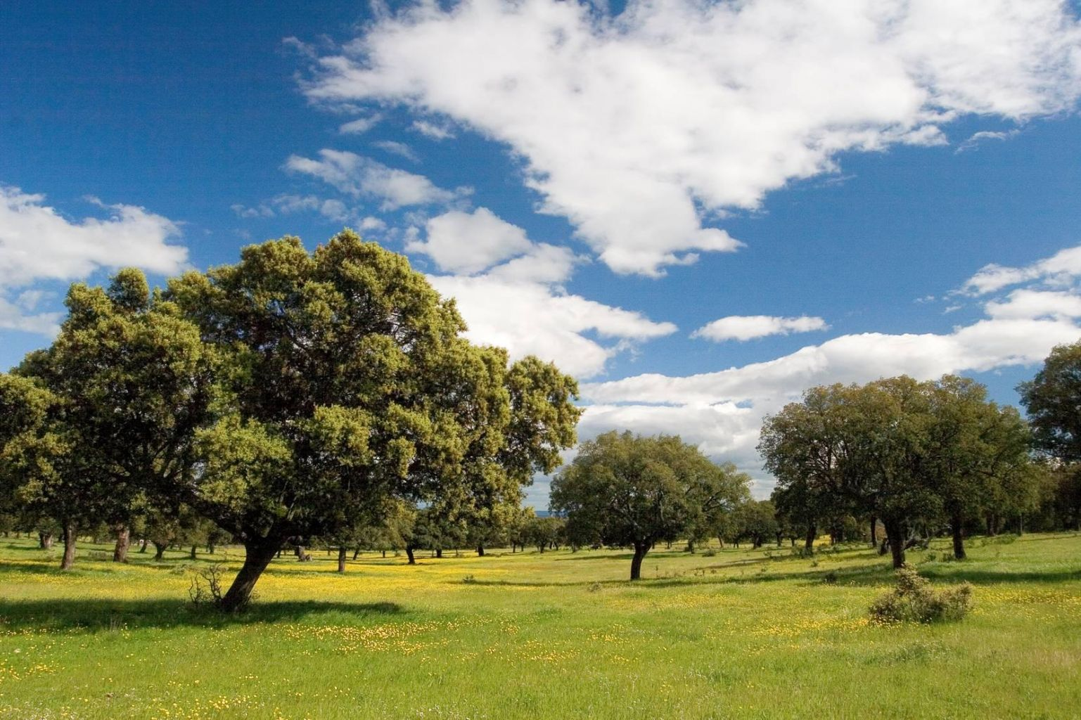
Global carbon uptake is an issue of scale and diversity

Slide 26
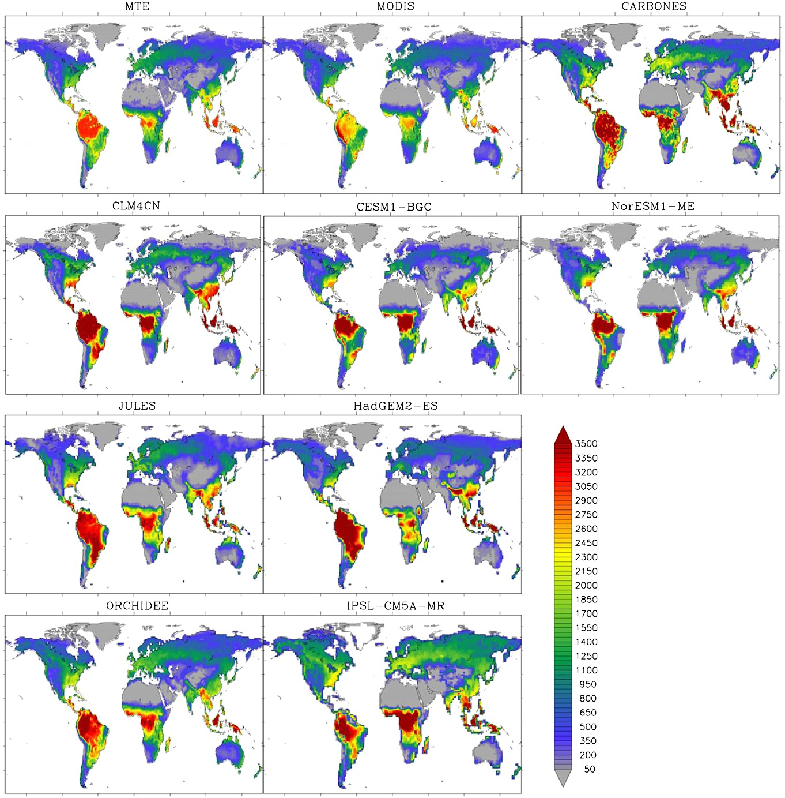
Global carbon uptake
From ground-based data, satellite data or process-based understanding, or a combination of all these
Notes:
Anav, A., et al. (2015), Spatiotemporal patterns of terrestrial gross primary production: A review, Rev. Geophys., 53, 785–818, doi:10.1002/2015RG000483.

Slide 27
The ecosystem carbon cycle
C uptake:
photosynthesis
C release:
respiration
C release:
Soil respiration
C storage:
growth
Internal cycling::
litterfall
C storage in soil

Slide 28
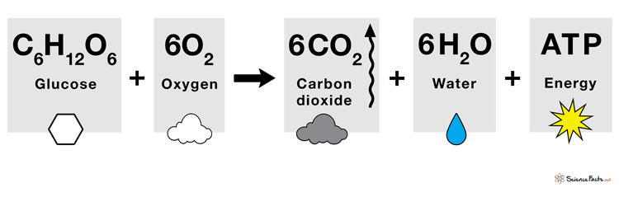
respiration is the process by which sugars are used to produce energy, releasing atmospheric CO₂

Slide 29
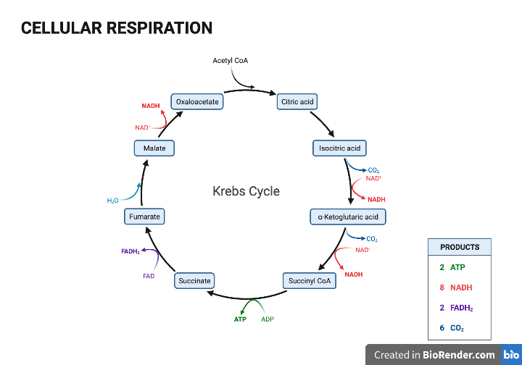
Respiration biochemistry
Cell respiration is a series of biochemical reactions

Slide 30
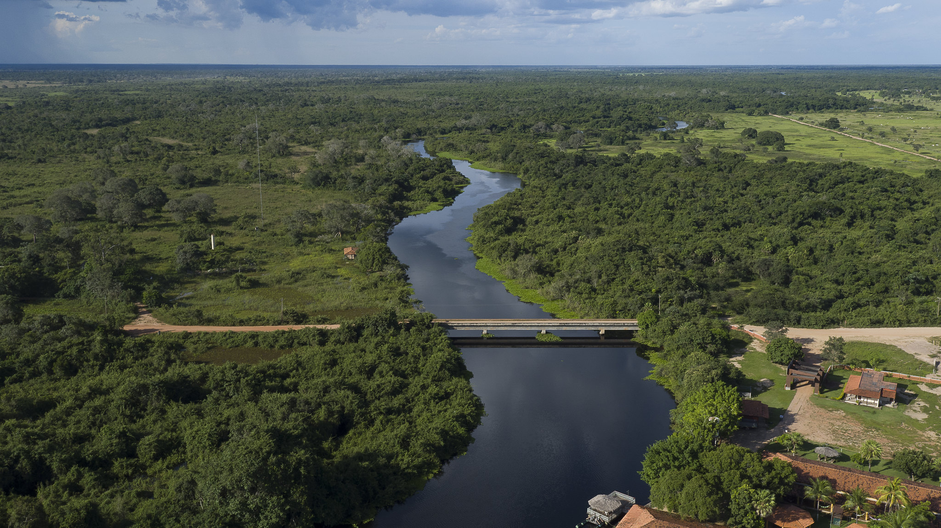
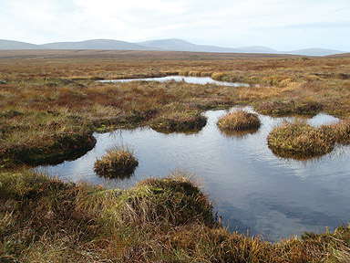
Anaerobic respiration: methanogenesis

Slide 31
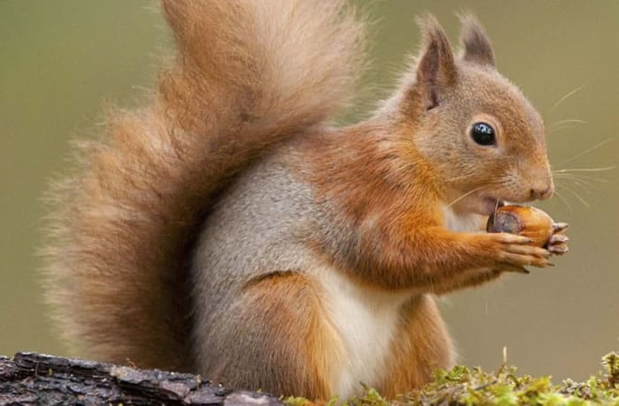
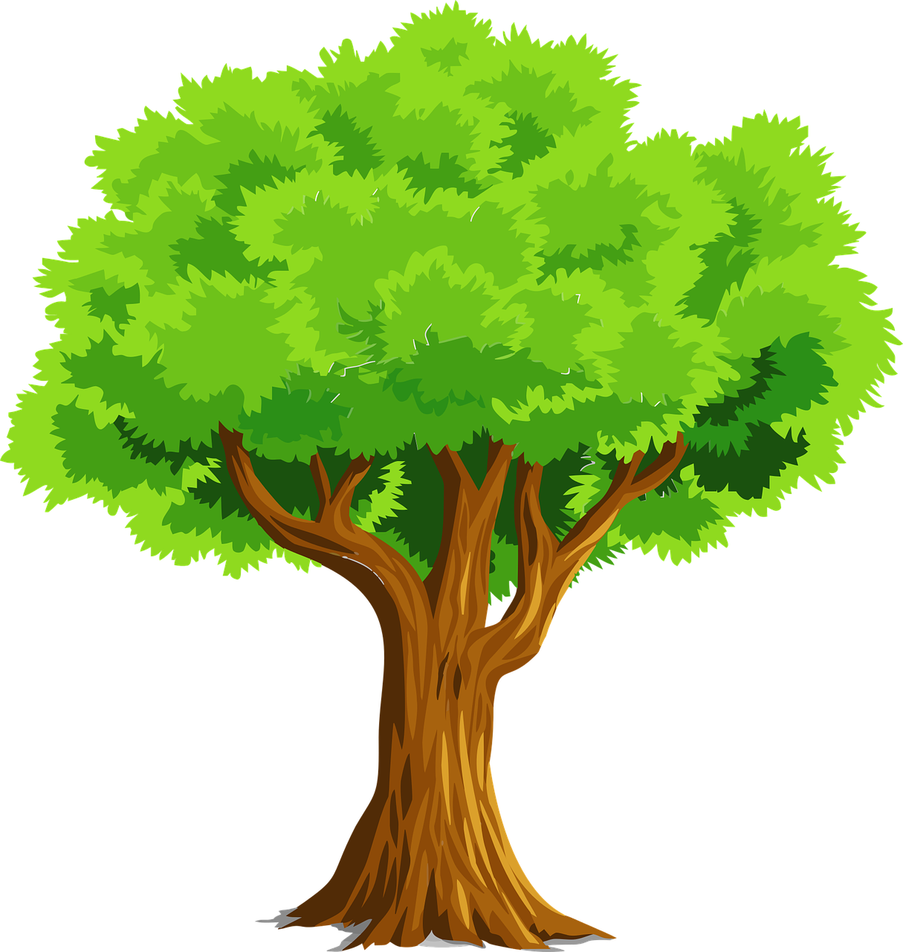
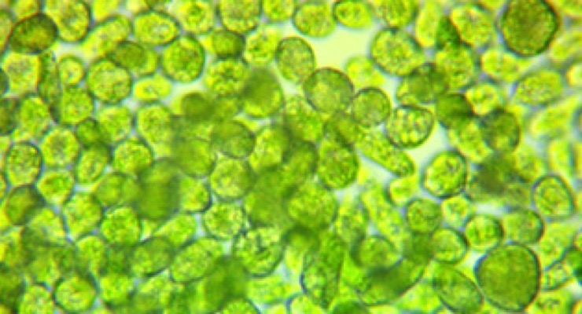
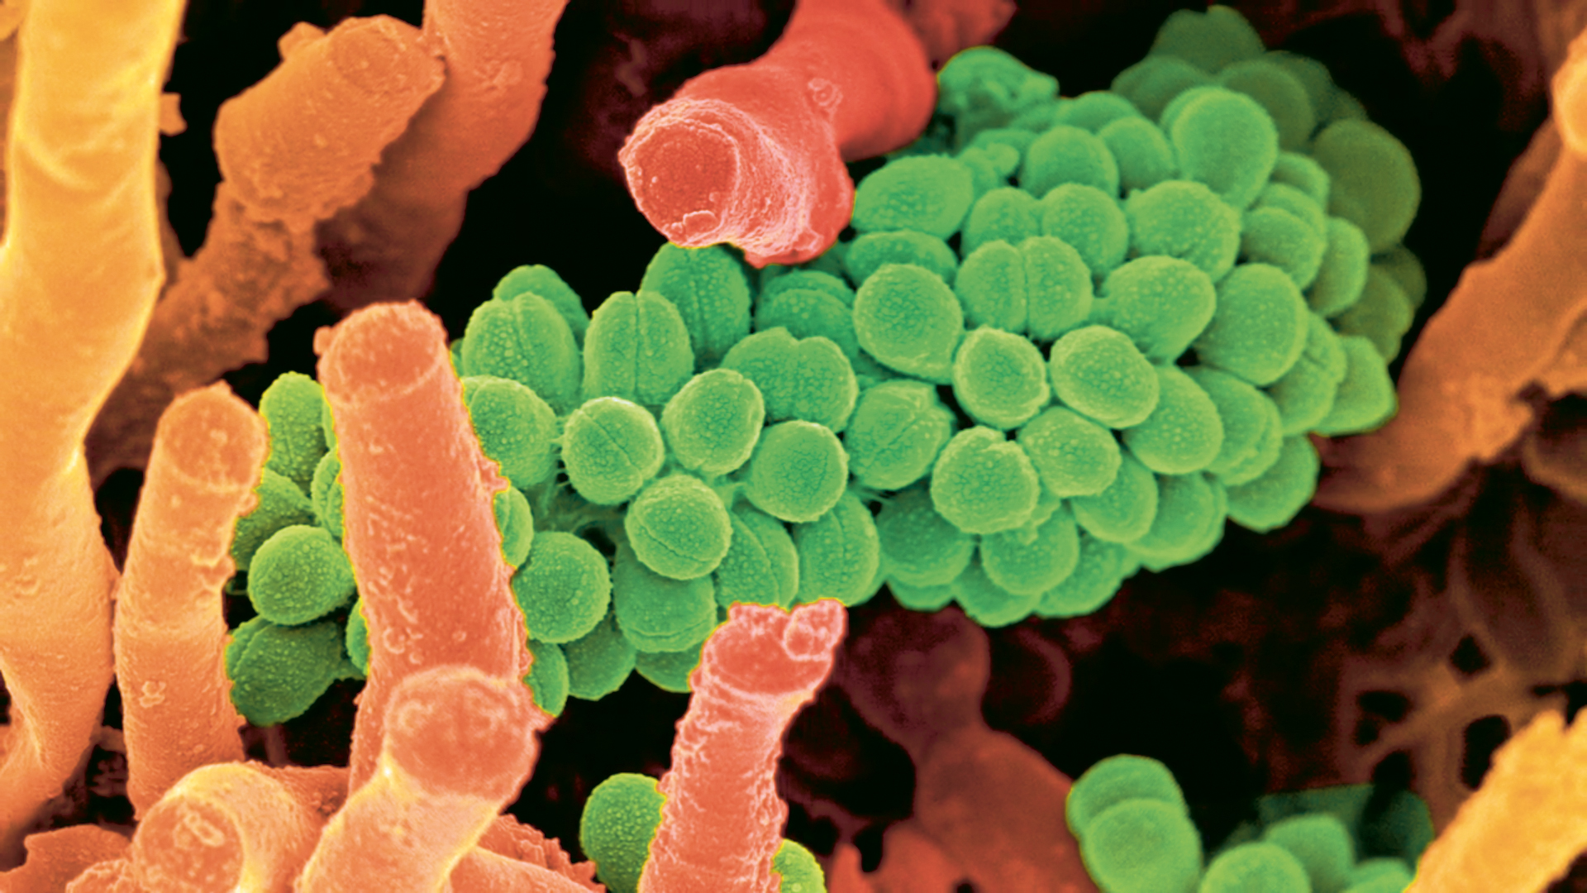

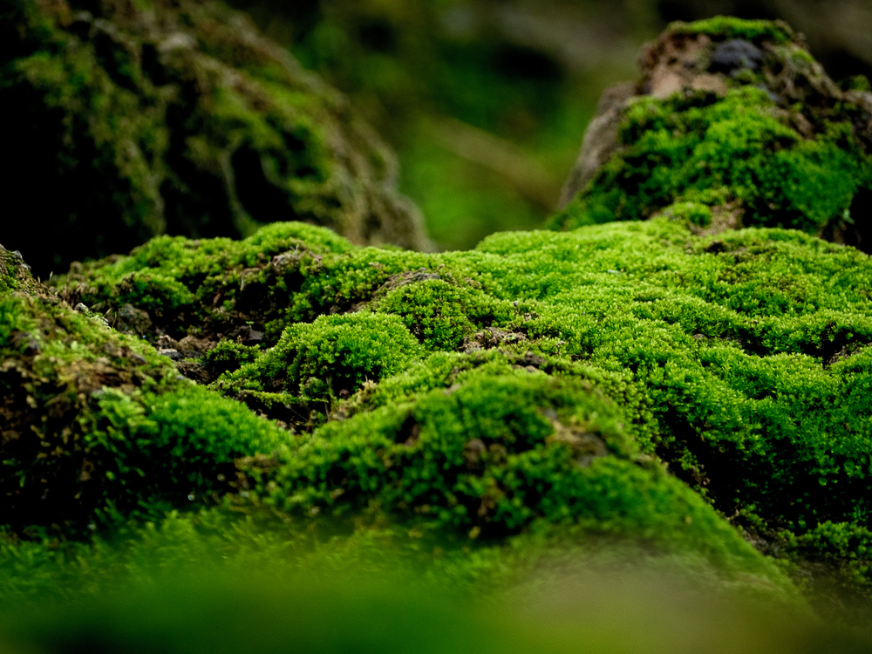
All organisms respire

Slide 32
Ecosystem respiration
Source of respiration hard to identify from measurements so we often talk about ecosystem level fluxes
Autottrphic
respiration
Heterotrophic respiration

Slide 33
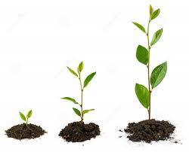
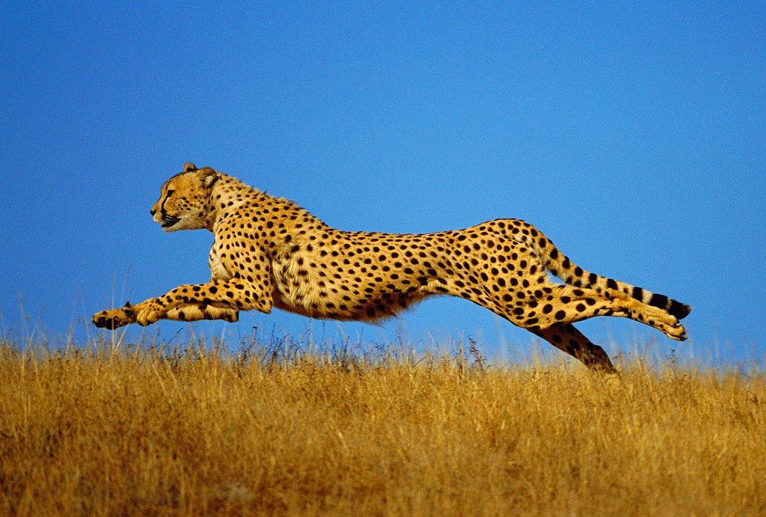
Respiration is a lot of things
Energy needed for function
Energy needed for growth

Slide 34
Controls on respiration
Substrate:
How much stuff there is to use
Energy requirement:
How much stuff the organism needs to do

Slide 35
Chemical reaction rates are controlled by temperature
Higher temperature means more energy available for reactions to take place

Slide 36
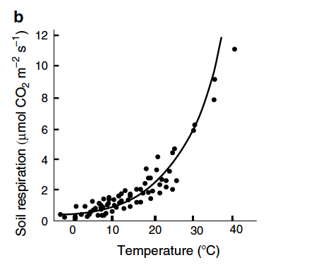
Respiration dependency on temperature

Slide 37
The ecosystem carbon cycle
C uptake:
photosynthesis
C release:
respiration
C release:
Soil respiration
C storage:
growth
Internal cycling::
litterfall
C storage in soil

Slide 38
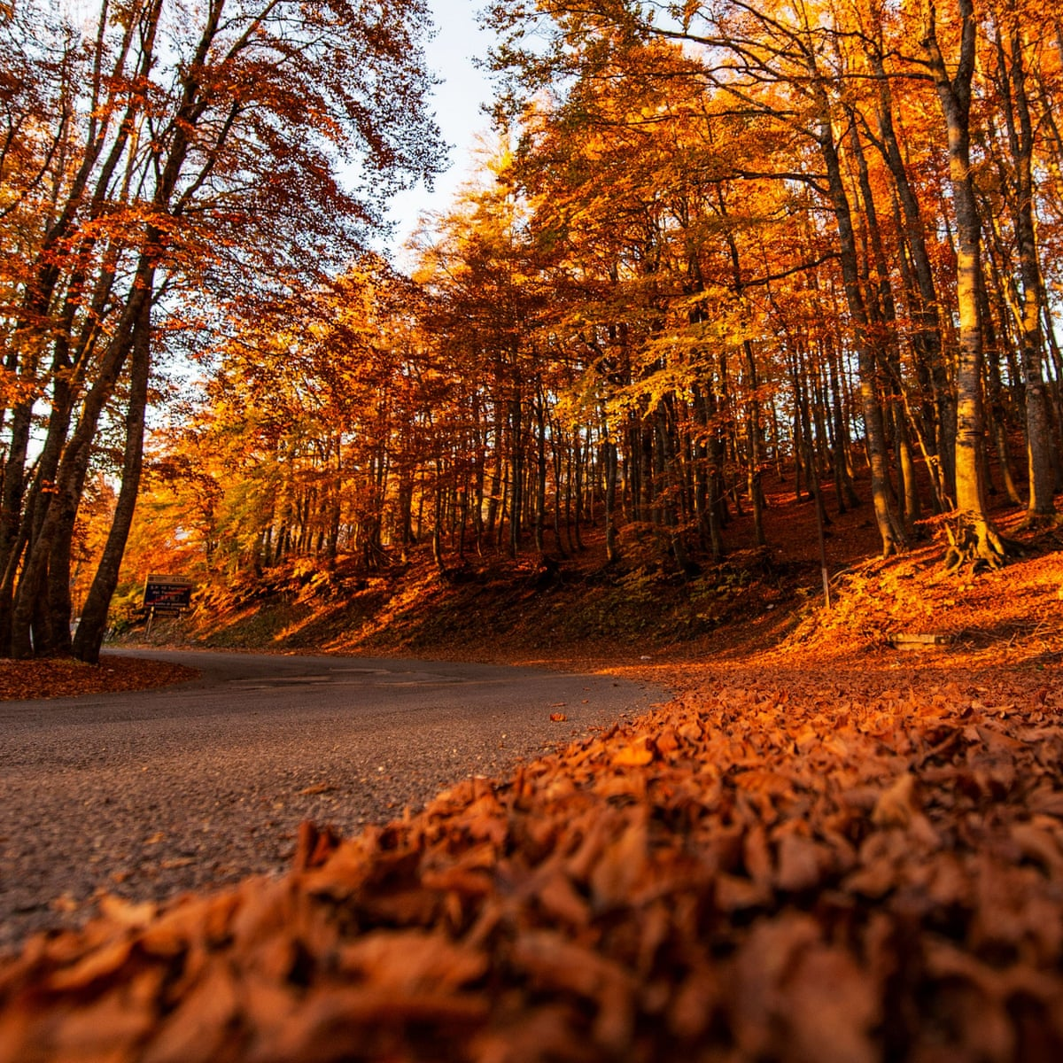
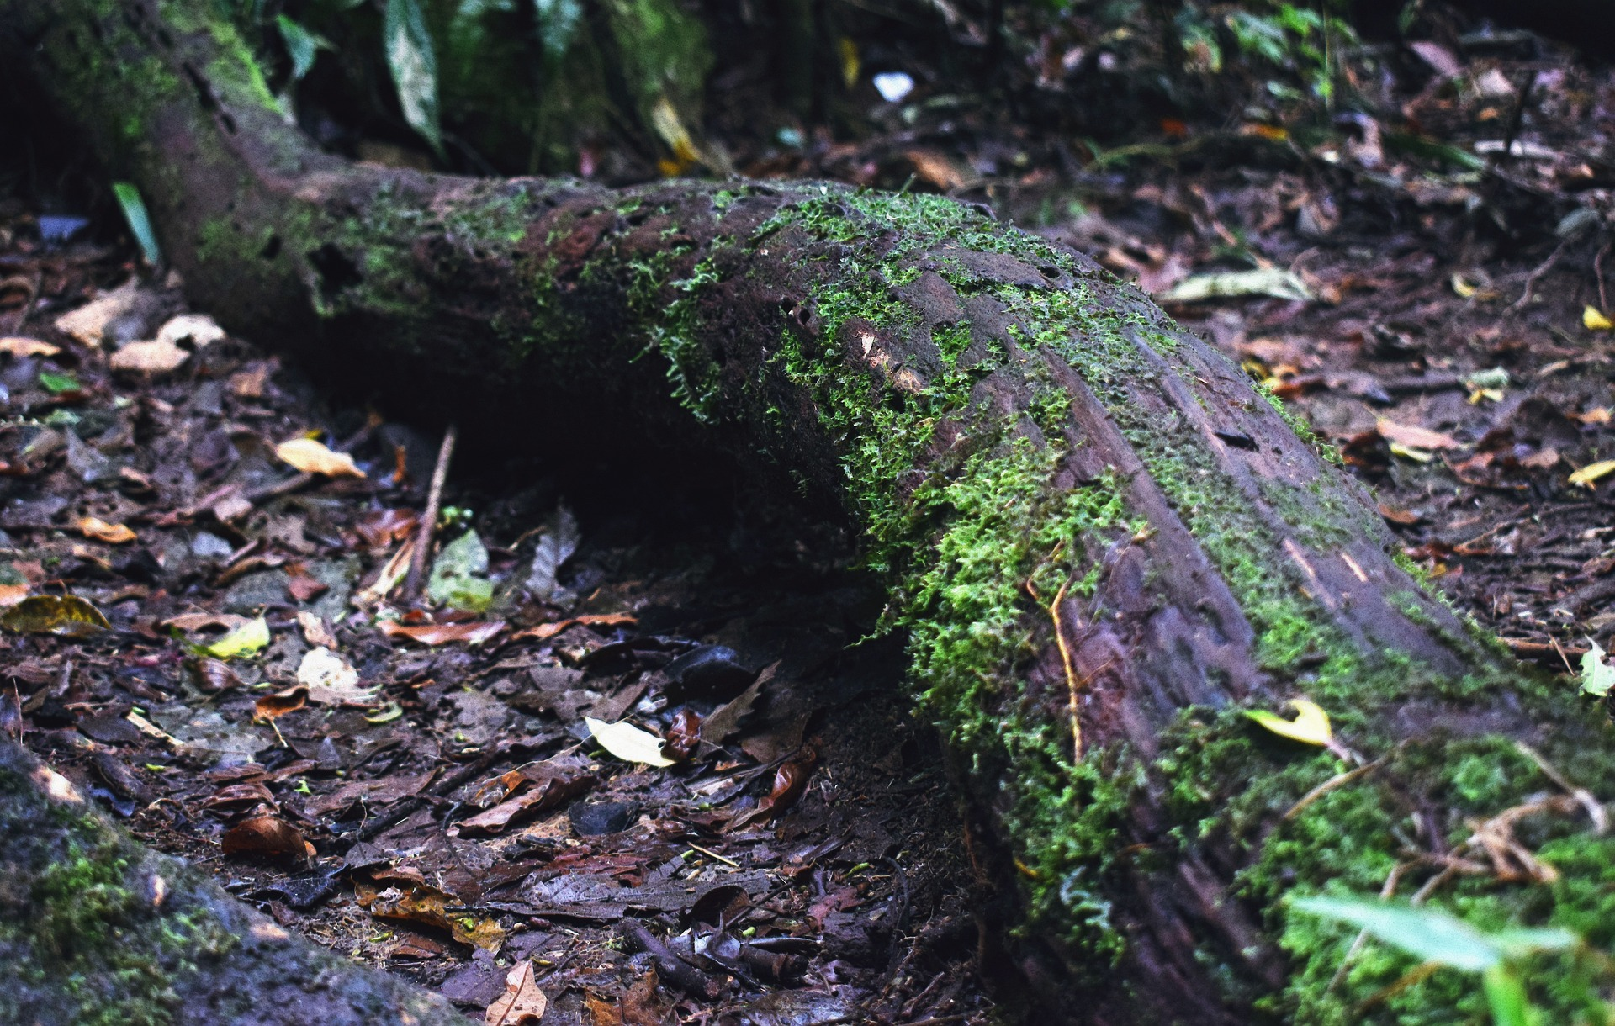
Internal ecosystem cycling
Seasonally senescing leaves
Dead trees, fallen twigs

Slide 39
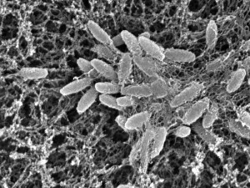
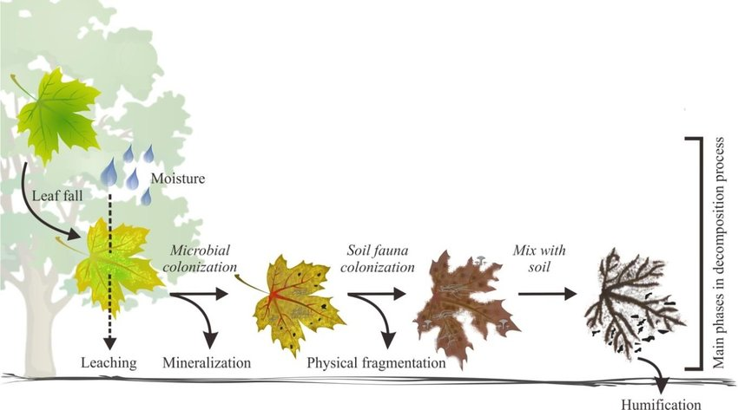
Respiration in the soil: organic matter decomposition

Slide 41
Up next
Monday 3/02 no lecture, holiday
Tuesday 4/02 lecture terrestrial C pools
Thursday 6/02 no lecture
Monday 10/02 lecture ocean C cycle joint with BOU33105 Global Environmental Change. Same time and location, just more students

